Slide 1
Policy Analysis of the Affordable Health Care Act (ACA) on Premiums per Person
Ameesh Kumar (ID) Alex Ronczewski (83793521)

Slide 2
Abstract
We are looking at the impact of the Affordable Care Act (ACA) on health insurance premiums in the United States. Using data from the US Department of Labor, our project employs a difference-in-difference (DiD) approach to compare 40 states that adopted the ACA with 10 that did not. The analysis focuses on per capita premiums for both experience-rated and non-experience-rated contracts. The main goal of this project is to assess the effectiveness of the Act in improving healthcare affordability for average Americans.

Slide 3
Variables 1
VARIABLE | Units | Mean of Means | Mean of Standard Deviations | Overall Minimum | Overall Maximum
INS_PRSN_COVERED_EOY_CNT (Insured Persons Covered End of Year Count) | Number of people | 1333.67 | 42041.70 | 0.00 | 9999999.00
WLFR_PREMIUM_RCVD_AMT (Welfare Premium Received Amount. It represents the total premiums received by the insurance company for the coverage provided during the policy year. This is only for experience-rated contracts.) | US Dollars | 2394116.44 | 937505906.19 | -130923183.00 | 8701261226322.00
WLFR_TOT_CHARGES_PAID_AMT (Welfare Total Charges Paid Amount. It represents the total amount of charges paid by the insurance company for claims during the policy year. This is for non-experience rated contracts.) | US Dollars | 2900620.40 | 1250374247.52 | -50876783.00 | 7708480105986.00

Slide 4
Variables 2
VARIABLE | Units | Mean of Means | Mean of Standard Deviations | Overall Minimum | Overall Maximum
SPONS_DFE_STATE (This variable represents the plan sponsor / Direct Filing Entity (DFE). It indicates the state where the plan sponsor or DFE is located.) | two-letter state IDs
WLFR_PREMIUM_RCVD_AMT_PER_CAPITA (Dividing WLFR_PREMIUM_RCVD_AMT by INS_PRSN_COVERED_EOY_CNT) | Number of people | 21864.86 | 13302903.79 | -178856.81 | 204126900569.05
WLFR_TOT_CHARGES_PAID_AMT_PER_CAPITA (Dividing WLFR_TOT_CHARGES_PAID_AMT by INS_PRSN_COVERED_EOY_CNT) | US Dollars | 33723.96 | 16920728.97 | -4771105.50 | 211823456790.11
ID (plan Identification number) | Numeric Code

Slide 5
Control Variables
VARIABLE | Units | Mean | Standard Deviations | Overall Minimum | Overall Maximum
Inflation | Percentage | 2.55% | 1.63% | -0.36% | 8.00%
Inflation Annual Change | Percentage | 0.10% | 1.76% | -4.19% | 3.46%
Market Indicator (S&P 500 Yearly Growth) | Percentage | 7.1780% | 17.7607% | -38.49% | 29.6%
Federal Reserve Interest Rates () | Percentage | 1.91% | 1.99% | 0.08% | 6.24%

Slide 6
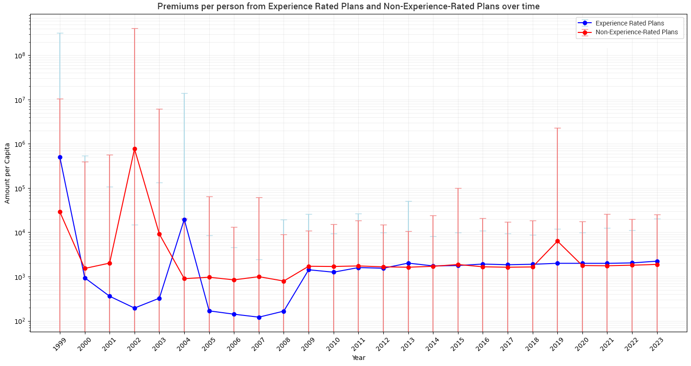
Variable over time

Slide 7
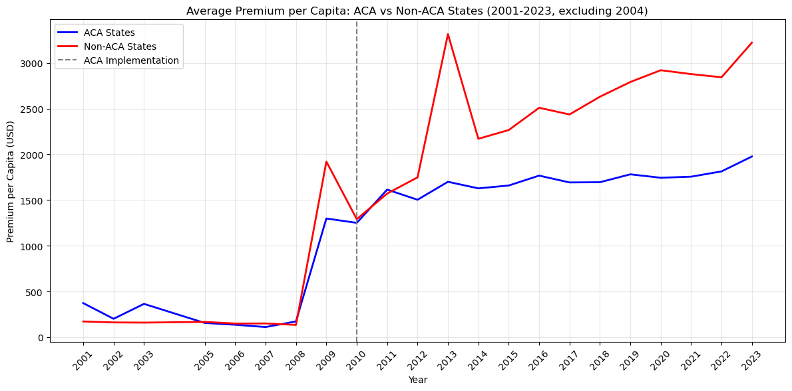
Parallel Trends

Slide 8
Methodology
The method we are going to use for our analysis is a difference-in-difference (DiD) regression to find the causal effect of the Affordable Care Act (ACA) on insurance premiums per person for both Experience Rated and Non-Experience Rated plans. We have decided on this approach for three reasons.
The implementation of the ACA creates a natural experiment where 40 states implemented it and 10 did not.
We had data from 1999-2023 and ACA was implemented in 2010 giving us long term post and pre-treatment data.
The implementation is also clear with the ACA becoming implemented in 2010.

Slide 9

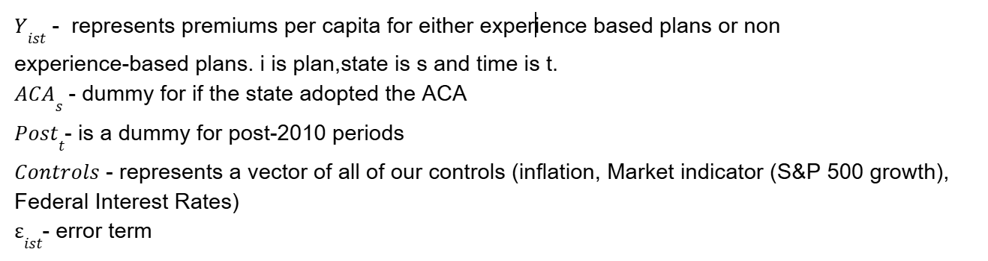
Regression Equation
As for Data cleaning for this regression to work we had to
Omit the years 1999, 2000 and 2004 because of the large variance and lack of data for these early years.
We also trimmed of 1% of outliers which we saw had to be dealt with from our minimums and maximums.
Log Transform Y (MAYBE)

Slide 10
Results of Regression (Without Controls)
Experience Rated Plans | Coefficient | Std Error | t-stat | p-value | CI Lower | CI Upper
Constant | 6.871 | 0.019 | 355.624 | ~0 | 6.833 | 6.908
ACA_State | -0.209 | 0.023 | -9.271 | ~0 | -0.254 | -0.165
Post_ACA | 0.868 | 0.023 | 37.119 | ~0 | 0.822 | 0.914
ACA_x_Post | -0.093 | 0.029 | -3.178 | 0.0015 | -0.150 | -0.035
Non-Experience Rated Plans | Coefficient | Std Error | t-stat | p-value | CI Lower | CI Upper
Constant | 4.667 | 0.021 | 221.402 | ~0 | 4.625 | 4.708
ACA_State | 0.681 | 0.024 | 28.132 | ~0 | 0.636 | 0.729
Post_ACA | 0.303 | 0.029 | 10.318 | ~0 | 0.245 | 0.360
ACA_x_Post | -0.020 | 0.035 | -0.567 | 0.570 | -0.088 | 0.048

Slide 11
Results of Regression (With Controls)
Experience Rated Plans | Coefficient | Std Error | t-stat | p-value | CI Lower | CI Upper
Constant | 7.199 | 0.025 | 285.530 | 0 | 7.150 | 7.248
ACA_{S} | -0.335 | 0.025 | -13.335 | ~0 | -0.385 | -0.286
Post_{t} | 0.472 | 0.027 | 17.642 | ~0 | 0.420 | 0.524
ACA_{S} * Post_{t} | 0.083 | 0.032 | 2.614 | 0.009 | 0.021 | 0.145
Inflation | 4.978 | 0.779 | 6.389 | 0.00000000016 | 3.451 | 6.505
Inflation Annual Change | -3.850 | 0.643 | -5.985 | 0.0000000021 | -5.110 | -2.589
S&P Yearly Growth | 0.003 | 0.0004 | 7.261 | ~0 | 0.002 | 0.004
Federal Funds Rate Average Yield | -6.681 | 0.696 | -9.593 | ~0 | -8.045 | -5.316

Slide 12
Results of Regression (With Controls)
Non-Experience Rated Plans | Coefficient | Std Error | t-stat | p-value | CI Lower | CI Upper
Constant | 4.251 | 0.030 | 139.548 | ~0 | 4.192 | 4.311
ACA_{S} | 0.754 | 0.028 | 26.579 | ~0 | 0.698 | 0.810
Post_{t} | 0.592 | 0.035 | 16.972 | ~0 | 0.524 | 0.660
ACA_{S} * Post_{t} | -0.154 | 0.038 | -4.011 | 0.00006 | -0.229 | -0.079
Inflation | 6.979 | 0.930 | 7.503 | ~0 | 5.156 | 8.802
Inflation Annual Change | -1.813 | 0.746 | -2.431 | 0.0152 | -3.275 | -0.351
S&P Yearly Growth | 0.0001 | 0.0005 | 0.326 | 0.7445 | -0.0009 | 0.001
Federal Funds Rate Average Yield | 8.207 | 0.766 | 10.720 | ~0 | 6.707 | 9.708

Slide 13
Interpretation of Results (Regression Without Controls)
EXPERIENCE RATED PLANS:
ACAs (β1): -0.209368
ACA States had 20.94% lower premiums per person than non ACA states before the implementation of the ACA.
Significant at p-value < 0.05
ACA_{S} * Post_{t} (β3): -0.092507
After the ACA implementation premiums per person in ACA states decreased by an additional 9.25% compared to non-ACA states.
The 95% confidence interval is [-0.149558, -0.035456] meaning that we can assume a negative effect.
Significant at p-value < 0.05
NON-EXPERIENCE-RATED PLANS
ACAs (β1): 0.680978
ACA states had 68.10% higher premiums per person than non-ACA states before the ACA was implemented.
Significant at p-value < 0.05
ACA_{S} * Post_{t} (β3): -0.019680
Not statistically significant (not distinguishable from 0 at p-value < 0.05)
1.97% decrease in premiums per person for ACA states after the implementation of the ACA.
Overall: For Experience Rated Plans there is evidence that premiums per person significantly decreased and for Non-Experience-Rated Plans there seems to have been no effect from the implementation of the ACA.

Slide 14
Interpretation of Results (Regression with Controls)
EXPERIENCE RATED PLANS:
ACA_{S} (β1): -0.335350
ACA states had 33.54% lower premiums per person than non-ACA states before the implementation of the ACA.
Statistically significant and 95% confidence interval is [-0.384639, -0.286061] suggesting a significant negative effect.
ACA_{S} * Post_{t} (β3): 0.082578
After the ACA implementation premiums per person in ACA states increased by 8.26%.
Statistically significant with the 95% confidence interval: [0.020664, 0.144492] suggesting a significant positive effect.
NON-EXPERIENCE-RATED PLANS
ACA_{S} (β1): 0.754043
ACA states had 75.40% higher premiums per person than non-ACA states before the ACA implementation.
The 95% confidence interval is [0.698440, 0.809646] suggesting a very significant positive effect.
ACA_{S} * Post_{t} (β3): -0.153902
After the ACA implementation premiums per person in ACA states decreased by 15.39% compared to non ACA states.
Statistically significant with the 95% confidence interval being [-0.229108, -0.078695].
Overall: For experience rated plans the ACA increased premiums per person while for Non-Experience-Rated Plans it decreased them, both results are significant.

